Slide 1
Data Science with Python

Slide 2
Data Science Overview

Slide 3

By the end of this lesson, you will be able to:
Define Data Science
Discuss the roles and responsibilities of a Data Scientist
List various applications of Data Science
Explain Data Science importance
Describe Python and its importance

Slide 4
Data Science

Slide 5

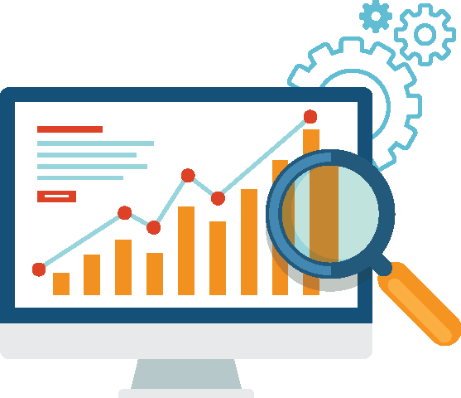
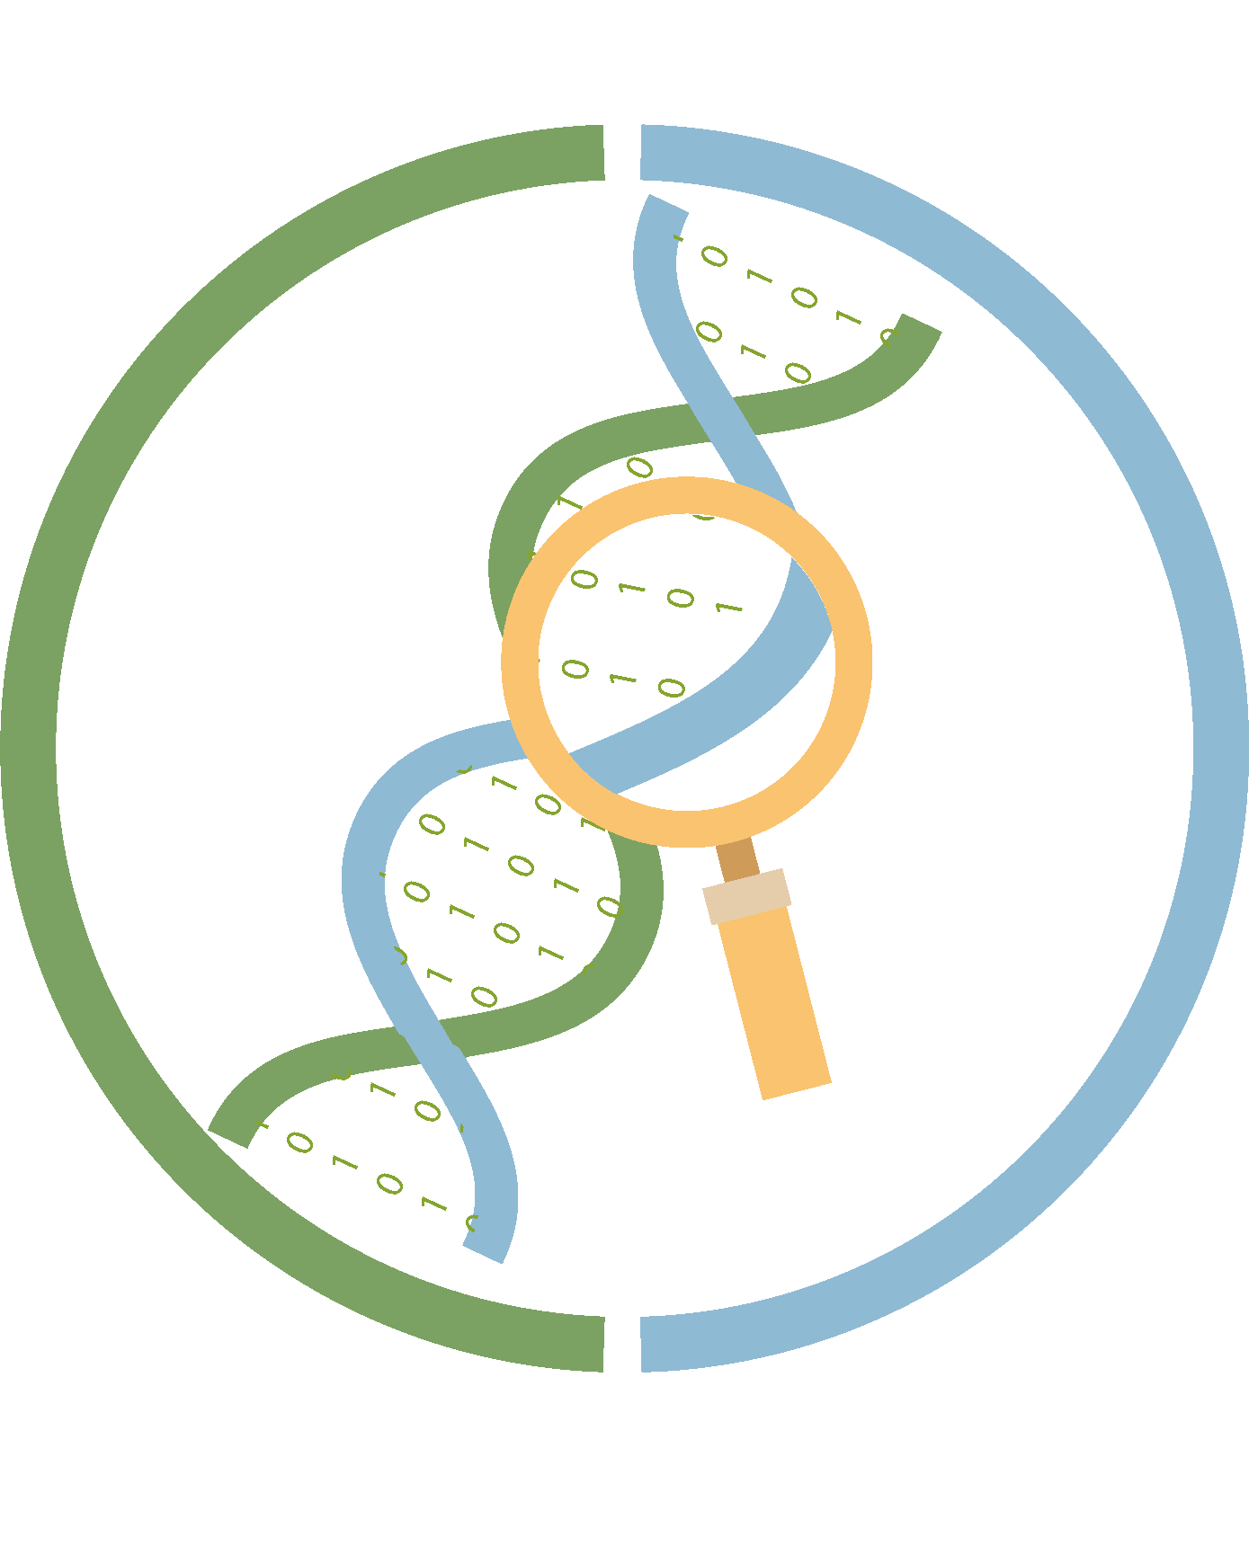
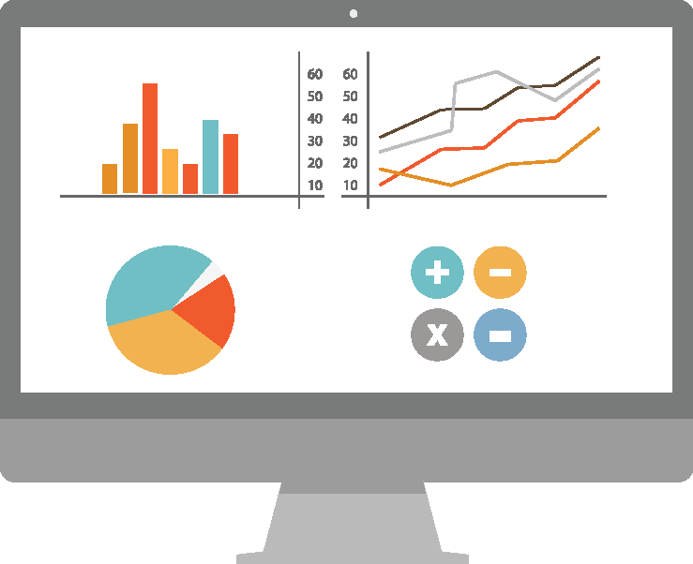
What Is Data Science?
Some common definitions of Data Science are:
A powerful new approach to make discoveries from data
An automated way to analyze enormous amounts of data and extract information
Data Science
A new discipline that combines the aspects of statistics, mathematics, programming, and visualization to turn data into information
Notes:
What is Data Science?
Let’s start with some of the common definitions that’s doing the rounds. Some say that Data Science is a powerful new approach for making discoveries from Data. Others term it an automated way to analyze enormous amount of Data and extract information from it. Still others refer to it as a new discipline which combines aspects of statistics, mathematics, programming, and visualization to gain insights.
Now that you have looked at some of its definitions, let’s learn more about Data Science.

Slide 6










Components of Data Science
When you combine domain expertise and scientific methods with technology, you get Data Science.
Domain Expertise and Scientific Methods
Technology
Operating Systems
Analysis
Python
Language
Application
Design
Mathematical and Statistical Models
Scientific
Tools and Methods
Data Science
Data Processing Tools
Library
Notes:
When domain expertise and scientific methods are combined with technology, we get Data Science which enables one to find solutions for existing problems.

Slide 7

Domain Expertise and Scientific Methods
Data Scientists collect, explore, analyze, and visualize data. They apply mathematical and statistical models to find patterns and solutions in the data.
Data analysis can be:
Descriptive: Study a dataset to decipher the details
Predictive: Create a model based on existing information to predict outcome and behavior
Prescriptive: Suggest actions for a given situation using the collected information
Analysis
Mathematical and Statistical Models
Scientific
Tools and Methods
Notes:
Let’s look at each of the components of Data Science separately. The first component is domain expertise and scientific methods.
Data Scientists should also be domain experts as they need to have a passion for data and discover the right patterns in them.
Traditionally, domain experts like scientists and statisticians collected and analyzed data in a laboratory setup or a controlled environment. The data was then subject to relevant laws or mathematical and statistical models to analyze the dataset and derive relevant information from it. For instance, they used the models to calculate the mean, median, mode, standard deviation, and so on of a dataset. It helped them test their hypothesis or create a new one.
In the next slide, we will see how Data Science technology has now made this process faster and more efficient. But before we do that, let’s understand the different types of data analysis, an important aspect of Data Science.
Data analysis can either be descriptive, where one studies a dataset to explain what happened, or be predictive, where one creates a model based on existing information to predict the outcome and behavior. It can also be prescriptive, where one suggests the action to be taken in a given situation using the collected information.

Slide 8
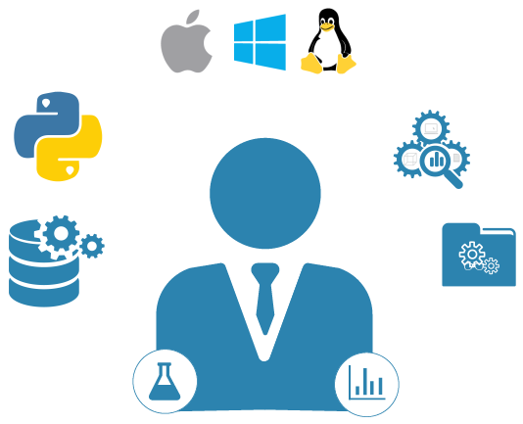
Data Processing and Analytics
Modern tools and technologies have made data processing and analytics faster and efficient.
These technologies help Data Scientists to:
Build and train machine learning models
Manipulate data with technology
Build data tools, applications, and services
Extract information from data
Technology
Operating System
Python
Language
Application
Design
Library
Data Processing Tools
Data analysis that uses only technology and domain knowledge without mathematical and statistical knowledge often leads to incorrect patterns and wrong interpretations. This can cause serious damage to businesses.
!
Notes:
We now have access to tools and technologies that process data and extract the information we need. For instance, there are data processing tools for data wrangling. We have new and flexible programming languages that are more efficient and easier to use. With the creation of Operating Systems that support multiple OS platforms, it is now easier to integrate systems and process Big Data. Application designs and extensive software libraries help develop more robust, scalable, and data-driven applications.
Data Scientists use these technologies to build data models and run them in an automated fashion to predict the outcome efficiently. This is called machine learning, which helps provide insights into the underlying data.
They can also use Data Science technology to manipulate data, extract information from it, and use it to build tools, applications, and services. But technological skills and domain expertise alone, without the right mathematical and statistical knowledge, might lead Data Scientists to find incorrect patterns and convey the wrong information.

Slide 9
Roles and Responsibilities of a Data Scientist

Slide 10
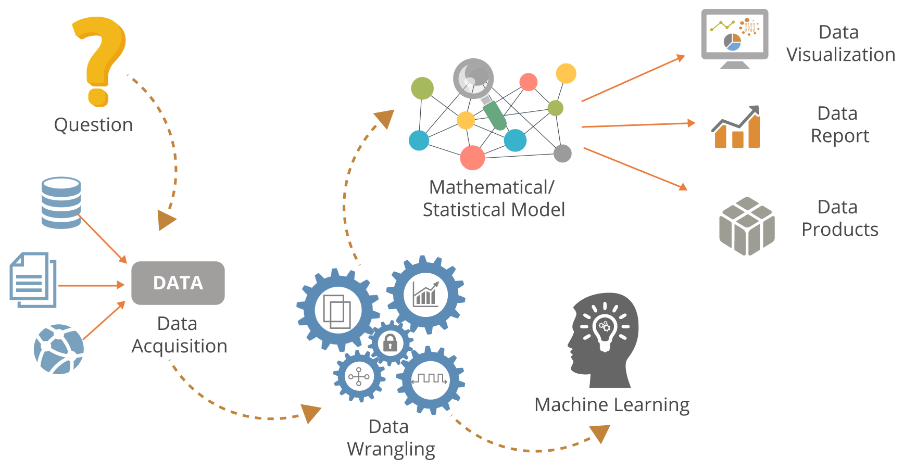
Role of a Data Scientist
Notes:
Now that you have learned what Data Science is, it will be easier to understand what a Data Scientist does:
Data Scientists start with a question or a business problem.
Then, they use data acquisition to collect datasets from the real world.
The process of data wrangling is implemented with data tools and modern technologies that includes data cleansing, data manipulation, data discovery, and data pattern identification.
The next step is to create and train models for machine learning.
They then design mathematical or statistical models.
After designing a data model, it is represented using data visualization techniques.
The next task is to prepare a data report.
After the report is prepared, they finally create data products and services.

Slide 11
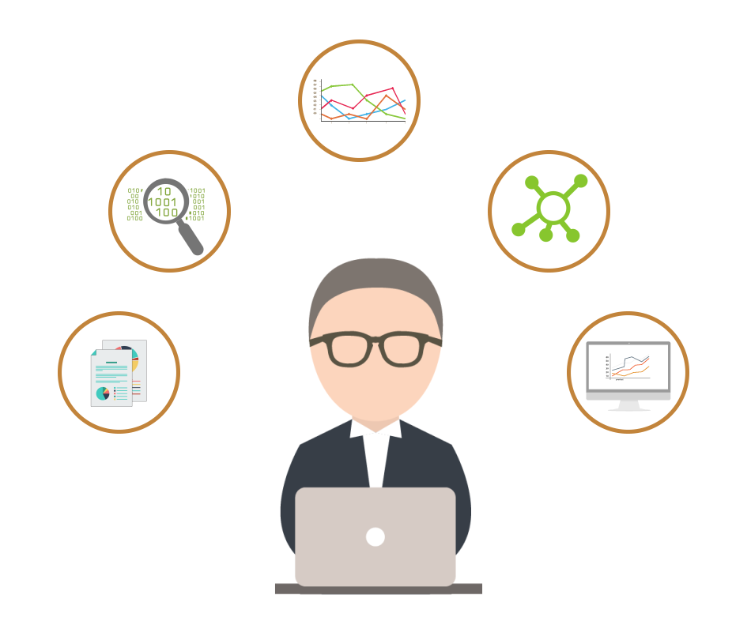
Basic Skills of a Data Scientist
A Data Scientist should be able to:
Ask the right questions
Understand data structure
Interpret and wrangle data
Apply statistical and mathematical methods
Visualize data and communicate with stakeholders
Work as a team player
Notes:
Let us now look at the various skills that a Data Scientist should have:
A Data Scientist should have the ability to ask the right set of questions. For this, it is important to have domain expertise, the curiosity to learn and create concepts, and the ability to communicate questions effectively to domain experts.
A Data Scientist should have an analytical mind to understand hidden patterns in a data structure.
They should also have the understanding to wrangle data by removing redundant and irrelevant data collected from various sources.
Statistical thinking and ability to apply mathematical methods are one of the most important traits that a Data Scientist should possess.
Data should be visualized with graphics and with the proper usage of storytelling. This helps the audience to analyze it. They should be able to design powerful presentations to summarize and communicate the analytical result to the audience.
To inculcate these skills, Data Scientists should follow a distinct roadmap. It is important that they learn the required tools and techniques, like Python and its libraries. They should be able to build projects using real world datasets that includes data.gov, NYC open data, gapminder and so on. They should also be able to build data driven applications for digital services and data products.

Slide 12
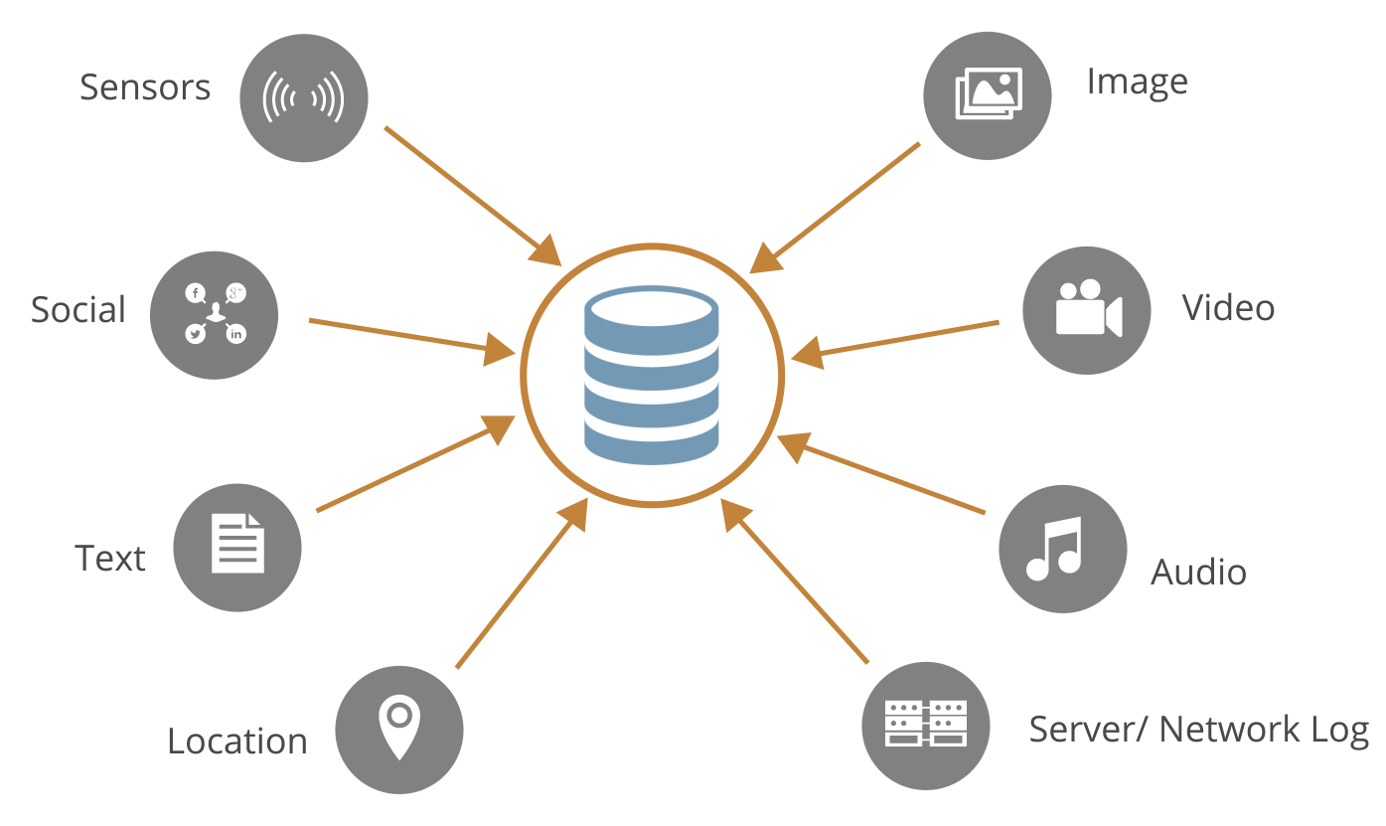
Sources of Big Data
Data Scientists work with different types of datasets for various purposes. Now that Big Data is generated every second through different media, the role of Data Science has become more important.
Notes:
Data Scientists work with different types of datasets for various purposes. Now that Big Data is generated every second through different media, the role of Data Science has become more important.
So you need to know what Big Data is and how you are connected to it to figure out a way to make it work for you.
Every time you record your heartbeat through your phone’s biometric sensors, post or tweet on the social network, create any blog or website, switch on your phone’s GPS network, upload or view an image, video, or audio, in fact, every time you log in to the Internet, you are generating data about yourself, your preferences, and your lifestyle.
Big Data is a collection of these and a lot more data that the world is constantly creating. In this age of the Internet of Things, or IOT, Big Data is a reality and a need.

Slide 13
3 Vs of Big Data
Volume
Enormous amount of data generated from various sources
Velocity
Large amount of data streaming in at great speeds, which requires quick data processing
Variety
Different formats of data: Structured, Semi-structured, and Unstructured
Big Data is a huge collection of data stored on distributed systems/machines popularly referred to as Hadoop clusters.
Data Science helps extract information from the data and build information-driven enterprises.
Notes:
Big Data is usually referenced by 3Vs — Volume, Velocity, and Variety
Volume refers to the enormous amount of data generated from various sources.
Big Data is also characterized by velocity. Huge amounts of data flow at a tremendous speed from different devices, sensors, and applications. To deal with it, an efficient and timely Data processing is required.
Variety is the third V of Big Data because Big Data can be categorized into different formats like Structured, Semi Structured, and Unstructured.
Structured Data is usually referred to as RDBMS data which can be stored and retrieved easily through SQLs.
Semi Structured Data are usually in the form of files like xml, json documents, and NoSQL database.
Texts files, images, videos, or multimedia content are examples of unstructured data.
In short, Big Data is a very large information database usually stored on distributed systems/machines popularly referred to as Hadoop clusters. But to be able to use this database, we have to find a way to extract the right information and data patterns from it. That’s where Data Science comes in. Data Science helps to build information driven enterprises.

Slide 14
Applications of Data Science

Slide 15
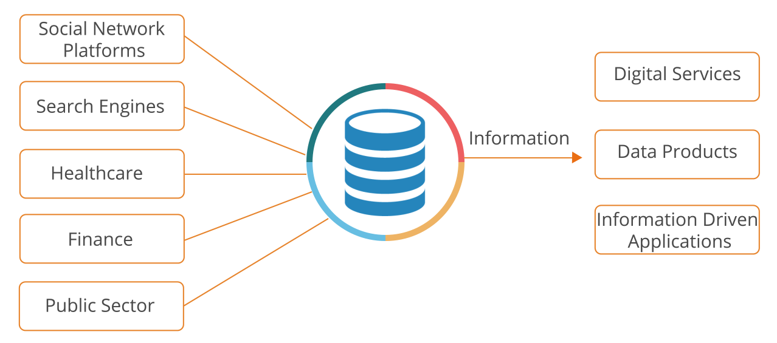
Different Sectors Using Data Science
Various sectors use Data Science to extract the information they need to create different services and products.
Notes:
We now know the skills a Data Scientist should have. Let’s go on to see the applications of Data Science in different sectors.
Social network platforms such as Google, Yahoo, Facebook, and so on collect a lot of data every day. Which is why they have some of the most advanced data centers spread across the world.
Having data centers all over the world and not just in the U.S. help these companies serve their international customers better, and faster, without any network latency. They also help them deal effectively with the enormous amount of data.
So, what do all these different sectors do with all this Big Data?
Their team of Data Scientists analyze all the raw data with the help of modern algorithms and data models to turn it into information. They then use this information to build digital services, data products, and information-driven web apps.

Slide 16
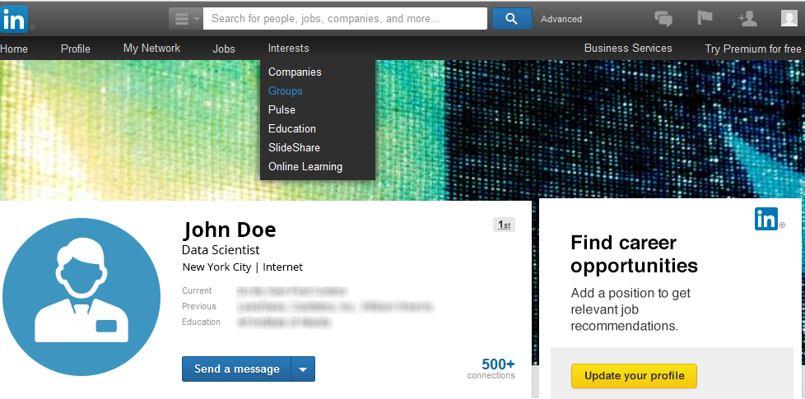
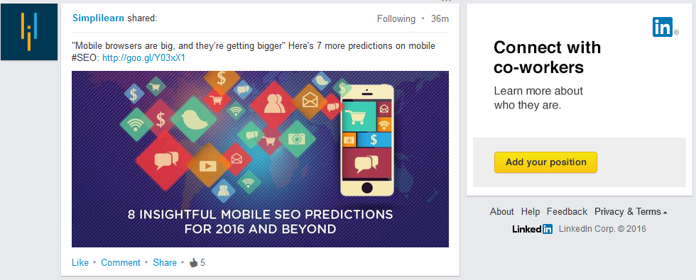
Using Data Science: Social Network Platforms
LinkedIn uses data points from its users to provide them with relevant digital services and data products.
Profile
Groups
Location
Digital Services
Data Points
Information
Connections
Data Products
Post
Likes
Notes:
Now let’s see how these products and services work. We’ll first look at LinkedIn.
Let’s suppose that you are a Data Scientist based in New York City. So it’s quite likely that you would want to join a group or build connections with people related to Data Science in NYC.
Now what LinkedIn does with the help of Data Science is that it looks at your profile, your posts, and likes, the city you are from, the people you are connected to and the groups you belong to; then it matches all that information with its own database to provide you with information that is most relevant to you.
This information could be in the form of news updates that you might be interested in; industry connections or professional groups that you might want to get in touch with; or even job postings related to your field and designation! These are all examples of data services.
Based on what LinkedIn is learning on its site, it has created a new education company called Lynda.com. It is a classic example of what a data product is.

Slide 17
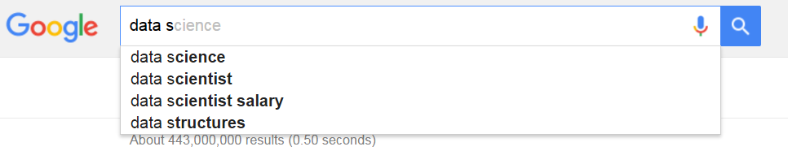
Using Data Science: Search Engines
Google uses Data Science to provide relevant search recommendations as the user types a query.
Search keyword
Autocomplete feature is fed by data models (Machine Learning)
Fast and real-time analytics is made possible by modern and advanced infrastructure, tools, and technologies
Influencing Factors
Query Volume – Unique and verifiable users
Geographical locations
Keyword/phrase matches on the web
Some scrubbing for inappropriate content
Notes:
Let’s now look at something that we use every day.
Google’s search engine.
Google’s search engine has the most unique search algorithm, which allows machine learning models to provide relevant search recommendations even as the user types in his or her query. This feature is called Auto Complete.
It is an excellent example of how powerful machine learning can be.
There are several factors that influence this feature:
The first one is Query Volume. Google’s algorithms identify unique and verifiable users that search for any particular ‘keyword’ on the web. Based on that, it builds a Query Volume. For instance ‘Republican debate 2016’, ‘Ebola threat’, ‘CDC or the Centre of Disease Control’, and so on are some of the most common user queries.
Another important factor is the geographical location. The algorithms tags a query with the locations from where it is generated. This makes a Query Volume location-specific. It’s a very important feature, because this allows Google to provide relevant search recommendations to its user based on his or her location.
And then, of course, the algorithms consider the actual keywords and phrases that the user types in. It takes up those words and crawls the web looking for similar instances.
The algorithms also try to filter or scrub out inappropriate content. For instance, sexual, violent, or terrorism-related content; hate speeches; and legal cases are scrubbed out from the search recommendations.

Slide 18

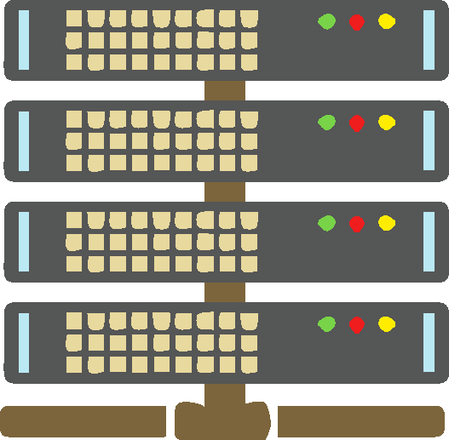


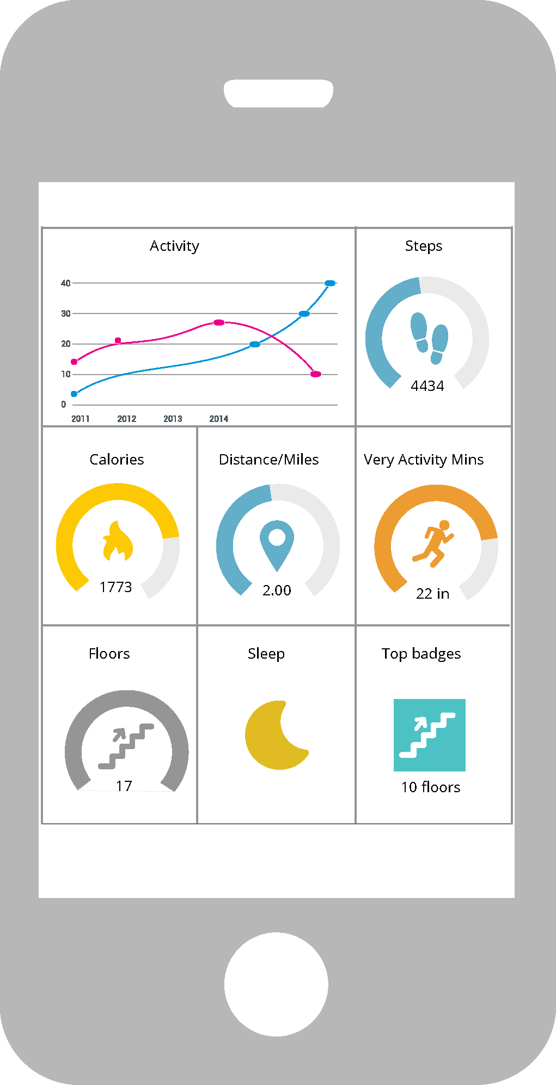

Using Data Science: Healthcare
Wearable devices use Data Science to analyze data gathered by their biometric sensors.
Biometric data transfer
IoT Gateway
Data transfer to Servers
Enterprise Infrastructure
Wearable device
Make informed decisions
Data Analytics
Engagement Dashboard
Notes:
But how does Data Science help you?
Today, even the healthcare industry is beginning to tap into the various applications of Data Science. To understand this, let’s look at wearable devices. These devices have biometric sensors and a built-in processor to gather data from your body when you are wearing them. They transmit this data to the Big Data analytics platform via the IOT gateway. Ideally, the platform collects hundreds of thousands of data points and the collected data is ingested into the system for further processing.
The Big Data analytics platform applies data models created by Data Scientists and extracts the information that is relevant to you. It sends the information to the engagement dashboard, where you can see how many steps you walked, what is your heart rate over a period of time, how good your sleep was, how much calories you burned, and so on. Knowing such details would help you to set personal goals for a healthy lifestyle, and reduce overall healthcare and insurance costs. It would also help your doctor record your vitals and diagnose any issue.

Slide 19



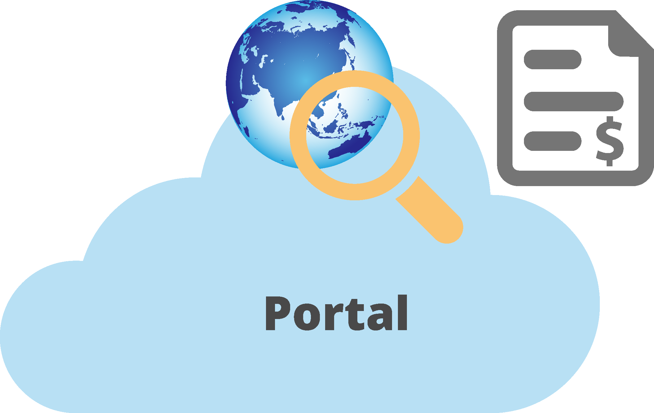








Using Data Science: Finance
A loan manager can easily access and sift through a loan applicant’s financial details using Data Science.
Data transfer to Servers
Enterprise Infrastructure
Loan Application Portal
Loan Applicant
Credit report, Credit history,
Approved amount, Risk etc.
Make informed decisions
Engagement Dashboard
Data Analytics
Notes:
The finance sector can easily use Data Science to help it function more efficiently.
Suppose a person applies for a loan. The loan manager submits the application to the enterprise infrastructure for processing. The analytics platform applies data models and algorithms and creates an engagement dashboard for the loan manger. The dashboard would show the applicant’s credit report, credit history, amount (if approved), and risks associated with him or her. The loan manager can now easily take a look at all the relevant information and decide whether the loan can be approved or not.

Slide 20
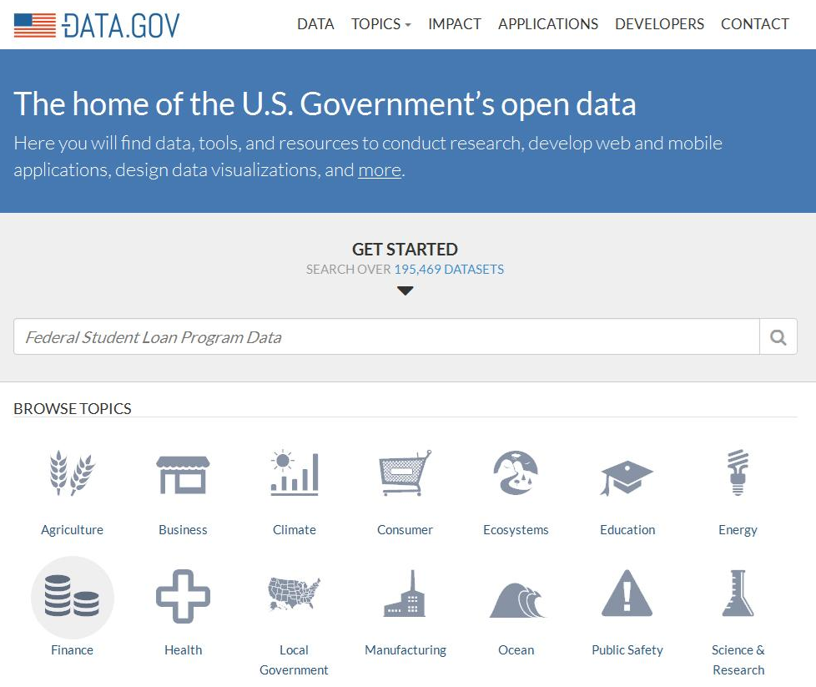
Using Data Science: Public Sector
The governments in different countries share large datasets from various domains with the public. Data.gov is a website hosted and maintained by the U.S. government.
Large collection of datasets
Sectors/Domains
Notes:
Governments across different countries are gradually sharing large datasets from various domains with the public. This kind of transparency makes the government seem more trustworthy. It provides the country data that can be used to prepare itself for different types of issues like climate change and disease control. It also helps encourage people to create their own digital products and services.
The U.S. government hosts and maintains data.gov, a website that offers information about the federal government. It provides access to 195 thousand datasets across different sectors.
The U.S. government has kicked off a number of strategic initiatives in the field of Data Science that includes U.S. Digital Service and Open data.

Slide 21
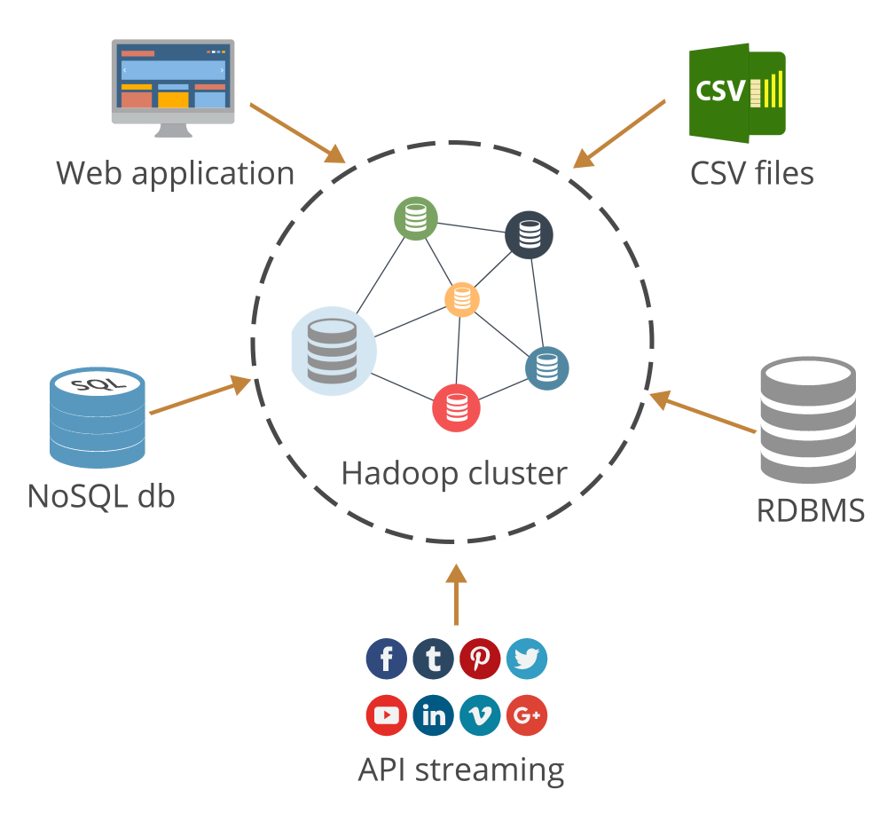
The Real Challenge
Some of the challenges Data Scientists face in the real world are:
Data quality doesn’t conform to the set standards
Data integration is a complex task
Data is distributed into large clusters in HDFS, which is difficult to integrate and analyze
Unstructured and semi-structured data are harder to analyze
Notes:
We have seen how Data Science can be applied across different sectors.
Let’s now take a look at the various challenges that a Data Scientist faces in the real world while dealing with datasets:
Data Quality: The quality of data is mostly not up to the set standards. You will usually come across data that is inconsistent, inaccurate, incomplete, not in the desirable format, and with anomalies.
Integration: Data integration with several enterprise applications and systems is a complex and painstaking task.
Unified platform: Data is distributed to Hadoop Distributed File System (HDFS) from various sources to ingest, process, analyze, and visualize huge datasets. The size of these Hadoop clusters can vary from few nodes to thousand nodes. The challenge is to perform analytics on these large datasets efficiently and effectively.
This is where Python comes into play with its powerful set of libraries, functions, modules, packages and extensions.

Slide 22
Python

Slide 23

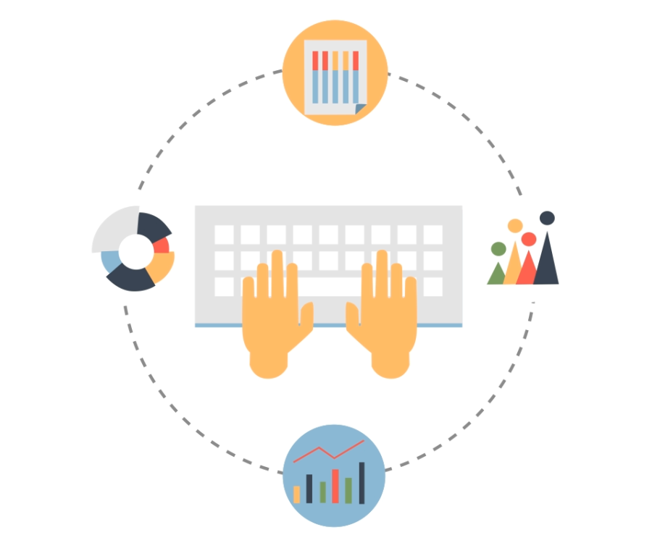
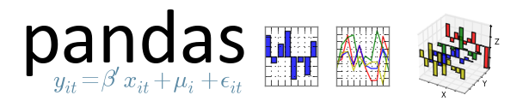
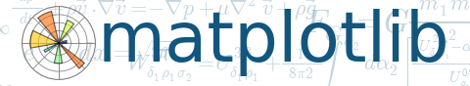




Data Analytics and Python
Python deals with each stage of data analytics efficiently by applying different libraries and packages.
Acquire
Wrangle
Explore
Model
Data Analytics
Visualize
Bokeh
Notes:
Python can efficiently tackle each stage of Data Analytics that includes:
Data acquisition – Python libraries such as Scrapy comes handy here.
Data wrangling – Pandas DataFrames are very efficient in handling large datasets and makes data wrangling easier with its powerful functions.
Explore – Matplotlib libraries are very rich when it comes to data exploration.
Model – SciKit learn’s statistical and mathematical functions help to build models for machine learning.
Visualization – Modern libraries such as Bokeh creates very intuitive and interactive visualization.
Its huge set of libraries and functions make Big Data analytics seem easy and hence solves the bigger problem.
Python applications and programs are portable and helps them scale out on any big data platform.

Slide 24
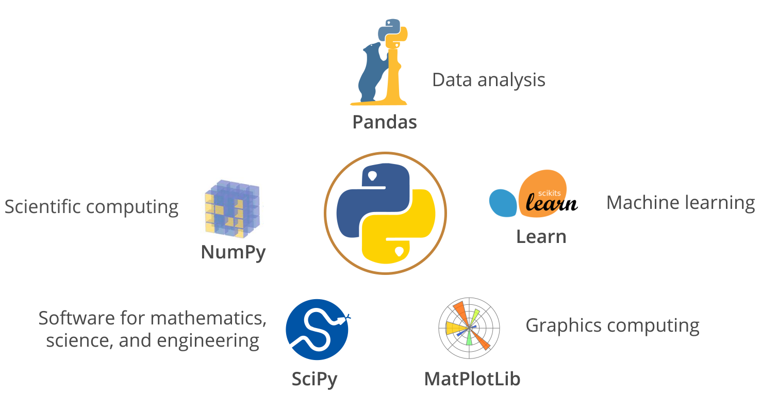
Python Tools and Technologies
Python is a general purpose, open source programming language that lets you work quickly and integrate systems more effectively.
Notes:
Python is an open source, programming language that lets you work quickly and integrate systems more effectively.
Now that we have talked about how the Python libraries help the different stages of data analytics, let’s take a closer look at these libraries and how they support different aspects of Data Science.
NumPy, or Numerical Python, is the fundamental package for scientific computing.
SciPy is the core of scientific computing libraries and provides many user-friendly and efficiently designed numerical routines.
MatPlotLib is a Python 2D plotting library which produces publication quality figures in a variety of hardcopy formats and interactive environments across platforms.
Scikit-learn is built on NumPy, SciPy, and Matplotlib for data mining and data analysis.
Pandas is a library providing high-performance, easy-to-use data structures and data analysis tools for Python.
All these libraries, modules, and packages are open source and hence using them is convenient and easy.

Slide 25
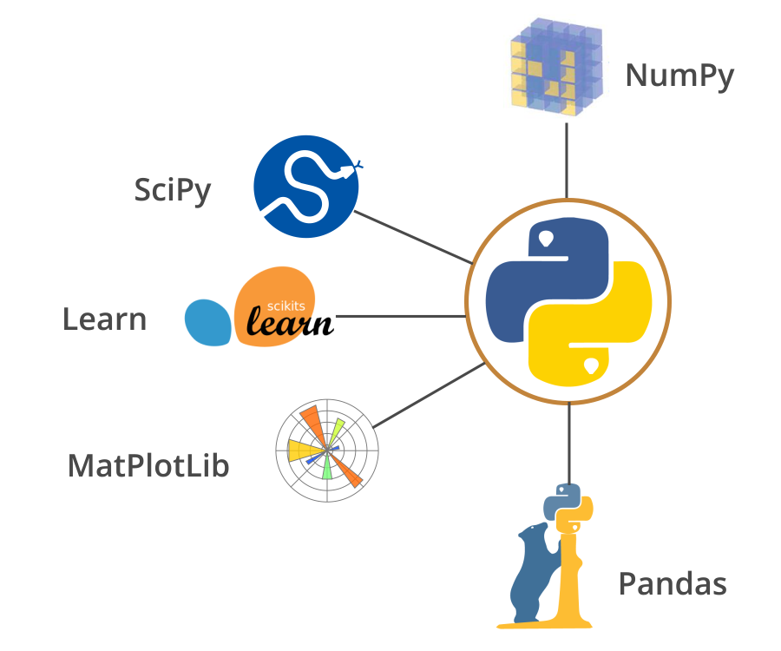
Benefits of Python
Easy to learn
Easy to learn
Open source
Open source
Efficient and multi-platform support
Efficient and multi platform support
Huge collection of libraries, functions, and modules
Huge collection of libraries, functions and modules
Big open source community
Big open source community
Integrates well with enterprise apps and systems
Integrates well with enterprise apps and systems
Great vendor and product support
Great vendor and product support
Notes:
There are numerous factors which positions Python well and makes it the tool for data science:
Python is easy to learn. It is a general purpose, functional, and object-oriented programming language.
As Python is an open source programming language, it is readily available, easy to install, and get started. It also has a large presence of open source community for software development and support.
Python and its tools enjoy multi-platform support. Applications developed with Python integrate easily with other enterprise systems and applications.
There are a lot of tools, platform, and products in the market from different vendors and they offer great support and services.
Python and its libraries create unique combinations for Data Science. Because of all these benefits, it is usually popular among academicians, mathematicians, statisticians, and technologists.

Slide 26






Big Data Platforms and Processing Frameworks for Python
Python is supported by well-established data platforms and processing frameworks that help analyze data in a simple and efficient way.
Data Scientist
Python
Tool for data analysis and processing
Big Data Processing Framework
Enterprise Big Data Platform
Big Data
Notes:
Python is supported by well-established Data platforms and processing frameworks that help it analyze Data in a simple and efficient way:
Enterprise Big Data Platform:
Cloudera is the pioneer in providing enterprise-ready Hadoop Big Data platform and supports Python
Hortonworks is another Hadoop Big Data platform provider and supports Python
MapReduce, MAPR, is also committed to Python and provides the Hadoop Big Data platform
Big Data Processing Framework:
MapReduce, Spark, and Flink provides very robust and unique data processing framework and support Python.
Java, Scala and Python languages are used for Big Data processing framework.

Slide 28
A Data Scientist _____.
1
Asks the right questions
Acquires data
Performs data wrangling and data visualization
All of the above

Slide 29
A Data Scientist _____.
1
Asks the right questions
Acquires data
Performs data wrangling and data visualization
All of the above
d
A Data Scientist asks the right questions to the stakeholders, acquires data from various sources and data points, performs data wrangling that makes the data available for analysis, and creates reports and plots for data visualization.

Slide 30
The search engine’s autocomplete feature identifies unique and verifiable users who search for a particular keyword or phrase to_____. Select all that apply.
2
Scrub inappropriate content
Build a query volume
Tag the location to a query
Find similar instances on the web

Slide 31
The search engine’s autocomplete feature identifies unique and verifiable users who search for a particular keyword or phrase to_____. Select all that apply.
2
Scrub inappropriate content
Build a query volume
Tag the location to a query
Find similar instances on the web
b, c
The search engine’s autocomplete feature identifies unique and verifiable users who search for a particular keyword or phrase to build a query volume. It also helps identify the users’ locations and tag them to the query, enabling it to be location-specific.

Slide 32
What is the sequential flow of Data Analytics?
3
Data wrangling, exploration, modeling, acquisition, and visualization
Data exploration, acquisition, modeling, wrangling, and visualization
Data acquisition, wrangling, exploration, modeling, and visualization
Data modeling, acquisition, exploration, wrangling, and visualization

Slide 33
What is the sequential flow of Data Analytics?
3
Data wrangling, exploration, modeling, acquisition, and visualization
Data exploration, acquisition, modeling, wrangling, and visualization
Data acquisition, wrangling, exploration, modeling, and visualization
Data modeling, acquisition, exploration, wrangling, and visualization
c
In Data Analytics, the data is acquired from various sources and is then wrangled to ease its analysis. This is followed by data exploration and data modeling. The final stage is data visualization, where the data is presented and the patterns are identified.

Slide 34
You are now able to:
Define Data Science
Discuss the roles and responsibilities of a Data Scientist
List various applications of Data Science
Explain Data Science importance
Describe Python and its importance

Slide 35
Thank You

